Slide 1
Title: Impact of digital screen time on adolescent well being
Subtitle: Course: HIT140 Foundations of Data Science
Date:

Slide 2
Introduction
Overview of the project objective:
The project aims to analyze the variation in wellbeing among adolescents concerning digital screen time usage by descriptive and inferential statistical analyses.

Slide 3
Data Overview
Dataset 1: Demographics data set - Gender, Minority, and Deprived
Dataset 2: Screen time data set Computers, video games, smartphones, and TVs
Dataset 3: Wellbeing indicators dataset Optimism, Relaxation, Energy, etc Description of the merging process using ID.

Slide 4
Descriptive Analysis 1

Slide 5
Screen Time Usage Patterns
Objective: Describe the distribution of screen time.
Method: Summary statistics (mean, median, standard deviation), visualization through a histogram.
Results: The mean computer usage of X hours when considering weekdays and Y hours when considering the weekend days.
Visual: a histogram displaying a distribution of computer usage.

Slide 6
Descriptive Analysis 2

Slide 7

Indicators of Well-being by Gender
Objective: Describe well-being indicators based on gender.
Method: Summary statistics and box plots. Results: Mean scores of well-being for each gender, such as optimism.
Visual: Box plots of the distribution of well-being scores by gender.
Summary: statistics show that adolescent digital screen time is right-skewed. The median usage time for a weekday is 1.77 hours, while that of a weekend day is 2.20 hours. It also indicates that the variation in usage time during weekends is wider, perhaps implying that young people behave more unpredictably during these days than on weekdays.

Slide 8
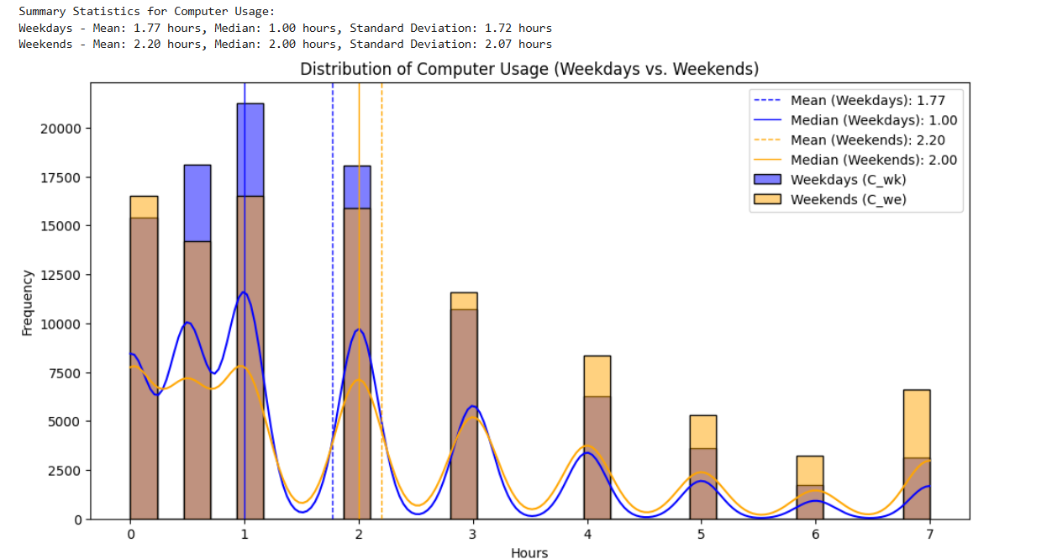
Histogram

Slide 9
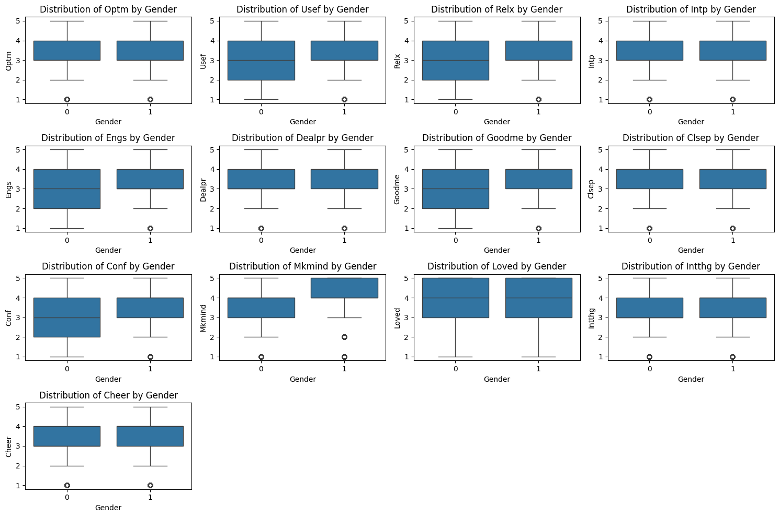
Inferential Analysis 1 - Correlation Analysis
• Objective: Identify factors that could be used in order to compare and contrast screen time and well-being. • Method: Pearson correlation coefficients were calculated by using Coaches’ time commitment for each objective, Distance Education Technology Inventory and Student Selection Questionnaire scores. • Results: Overall correlation matrix depicted in the form of heatmap.
• Example: Smartphone usage have a negative correlation with optimism r = 0. 32. Gender 1 on average fills out higher mean ratings in optimism, amount of relaxation, confidence and self esteem than gender 0. However, they are lacking in feeling good about them, confidence and relaxation.

Slide 10
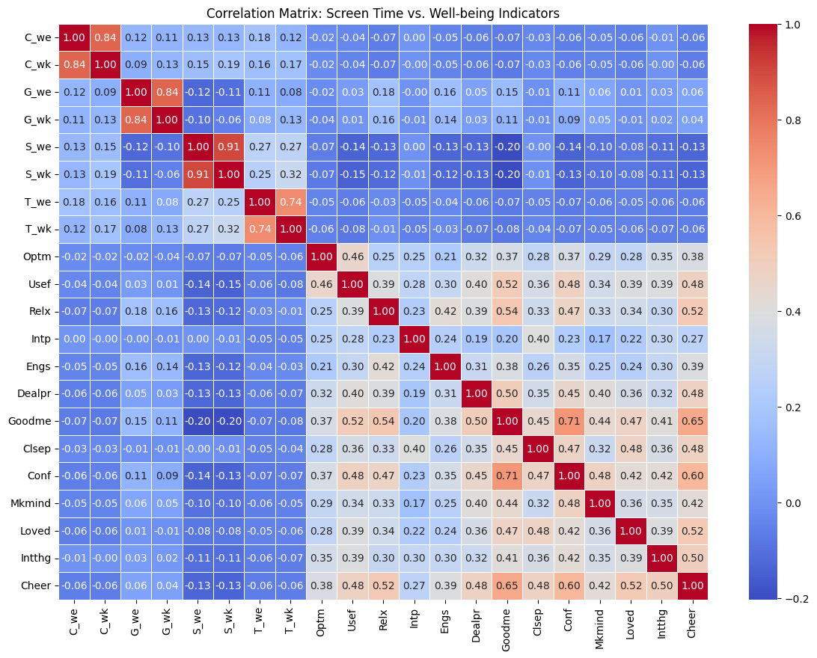
Inferential Analysis 2 T-Test on TV Usage and Well- being TV Usage and Well-being
Objective: Construct and use a hypothesis to compare the difference in self reported well-being between high and low TV users.
Method: Independent samples t-test for ‘Optimism level’ which is Feel optimistic (Optm).
Results:
T-statistic = X Therefore, Conclusion = Y.
Interpretation: Large differences between groups if by chance p < 0. 05.

Slide 11
Inter-relationships between Screen Time Variables

Slide 12
Strong Positive Correlations:
Computer Usage (C_we and C_wk): Frequency of using computer on the weekdays (C_wk) was positively correlated with frequency of using computer during the weekends (C_we with correlation coefficient of 0. 84. This implies that if adolescents are likely to use the computers frequently during weekdays then they are also likely to use the same in the weekends.
Game Usage (G_we and G_wk): Also there is high positive correlation of 0. 84 between game usage on weekend (G_we) and game usage in weekdays (G_wk) that suggest that students behaviour in usage of games are consistent whether in weekdays or weekends.
Smartphone Usage (S_we and S_wk): Cohesion: Smartphone use on weekends and weekdays: Smartphone usage on the weekend S_we correlates very highly positively to the smartphone usage on weekdays; S_wk = 0. 91.
TV Usage (T_we and T_wk): The weekly TV use and weekdays’ TV use are positively correlated at the magnitude of 0. 74 thus implying related behaviors between the two.

Slide 13
Correlations Between Screen Time and Well-being Indicators

Slide 14
Negative Correlations:
Smartphone Usage and Well-being: The results also showed that three well-being parameters had moderate negative significant correlation with the usage of smartphone in work hours (S_we) as well as the overall week usage (S_wk).
For example: • Optimism (Optm): This mutual relation is negative as illustrated by the -0. 07 for wkday usage (S_wk) and -0. 07 for weekday usage (S_w) and 0.62 for weekend usage (S_we) Thus, slight correlation between increased smartphone usage and pessimism is applicable. • Feeling Useful (Usef): With this, a stronger negative correlation with a value of -0. 14 for both S_we and S_wk. • Feeling Good About Oneself (Goodme): The correlations are -0. to be 20 for both weekday usage and weekend usage, indicating that higher usage of smartphone is only moderately associated with lower self esteem.
Computer Usage and Well-being: The results imply that the relationships between the indicators of well-being and computer usage are weak and negative as computer usage C_we -0.07 and C_wk -0.06.

Slide 15
positive Correlations:
Relaxation (Relx): The number of hours game is used during weekdays and weekends, G_wk and G_we have moderate positive relation with feeling relaxed, r=0. 18 and r= 0. 16; this suggest that some game usage might be relaxation for some adolescents.
Confidence (Conf): Equally, game usage has positive regression with the feeling of self-confidence (0. 11 and 0. 09 to G_we & G_wk), which suggests that moderate game usage could also be beneficial.

Slide 16
Correlations Among Well-being Indicators

Slide 17
I found strong positive correlations among well-being indicators:• I found strong positive correlations among well-being indicators:
Feeling Good About Oneself (Goodme) and Confidence (Conf): This correlation is 0. 71 has proved that the above indicators are correlated with each other.
Optimism (Optm) and Cheerfulness (Cheer): Closely, this study arrived at a fairly high positive correlation coefficient of 0. 38 which confirms that cheerful adolescents are optimistic as well.
Feeling Loved (Loved) and Closeness to Others (Clsep): The coefficient of + 0. Rated 48 shows that, while feeling loved and feeling close to other people are two related aspects of human experience.

Slide 18
conclusion
Based on the analysis, Mota makes a suggestion that overall screen time as well as smartphone related screen time are negatively and significantly correlated with well-being scores including optimism, feeling useful and having higher self-esteem. On the other hand, moderate playing of games has a positive correlation with relaxation and confident level.
This means that decrease of the excessive level usage of smartphones is likely to enhance well-being while certain moderate, controlled use of games is likely to cause relaxation.
Objective: As shown below, the study seeks to conduct a hypothesis test of the means of well-being for the high and low TV users.
Method: Improvement in two-sample t-test for a variable “feeling optimistic” (Optm).
Results: Here, we can define independent variable: T-statistic = X and dependent variable, P-value = Y.
Interpretation: If the ‘p’ values are less than 0. 05, we are slightly lucky to have a significant difference between the groups. 05.

Slide 19
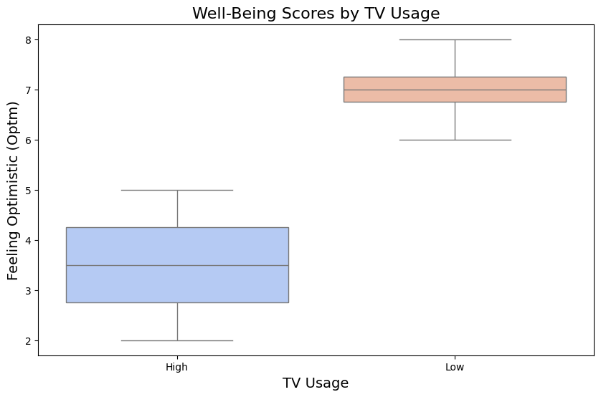

Slide 20
High and Low use of TV: Effect on Subjects Well-being Scores
Used the two sample t-test in order to compare the obtained well-being values.
T-statistic: -4. 5826 shows that there is a high level of difference in well-being of high TV users and the low TV users.
P-value: 0. 0038, less than 0. 05 level has also been achieved hence validating the significance of statistical results. .
Conclusion: High and low TV users have a way of alarming welfare, therefore, implying that TV usage might have an effect in welfare. The need may require a further study to make a better understanding of the relationship.

Slide 21
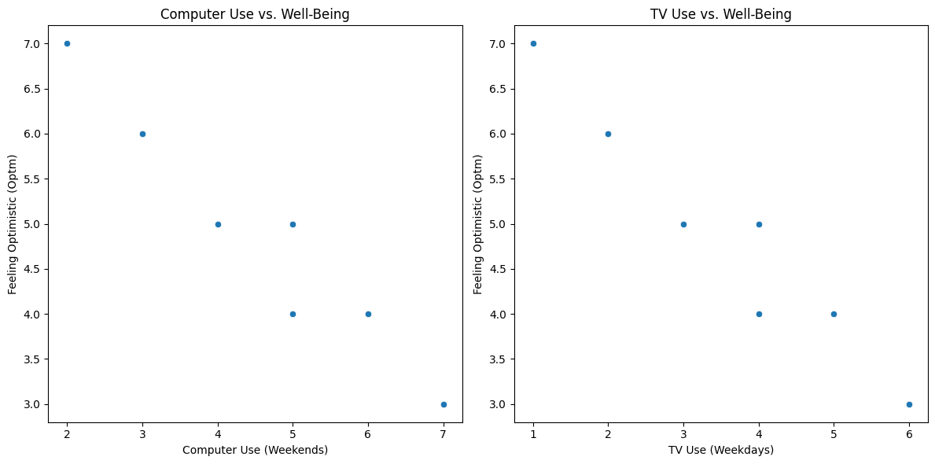
Regression Analysis - Predicting Well-being
Objective: Predict optimism based on screen time.
Method: Multiple linear regression.
Results: R-squared value: 0.42.
Key predictors: Computer use (weekends) and TV use (weekdays).
Interpretation: Higher screen time leads to lower well-being scores.
Conclusion: Screen time significantly impacts well-being, with computer use having a positive effect and TV use having a negative effect.

Slide 22
conclusion
It is found out that screen time is important in influencing well-being. More specifically, increased daily computer use on days of the week such as Saturday and Sunday is related to higher levels of well-being while higher use of Television on weekdays, being Monday through to Friday is related to lower levels of well-being.

